Slide 1
How Indexed Universal Life performs vs the S&P 500®

Slide 2
What’s Indexing?
Indexing is how interest is credited to your IUL policy
In rising market
Capture a portion of the potential growth of an index
In a falling market
Floor of zero, credited growth is not at risk from market drop

Slide 3
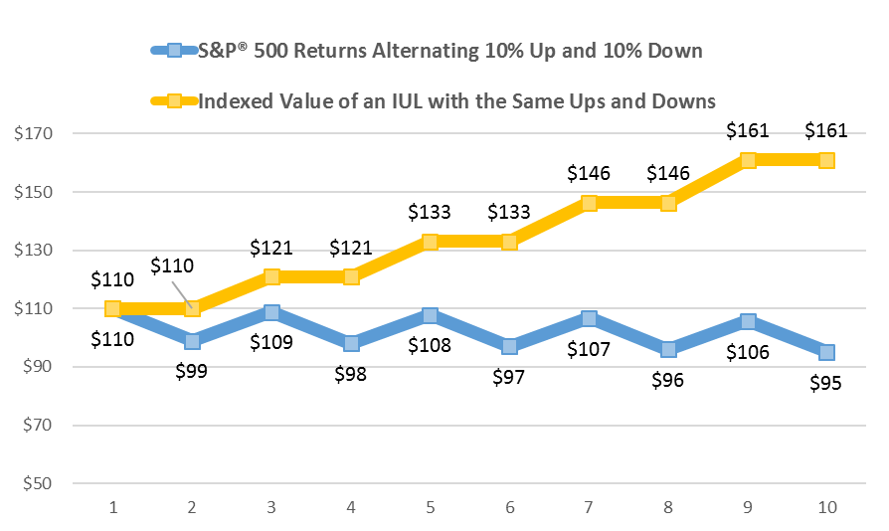
Indexing Protects Your Retirement From Market Downturns Your Account Will Avoid Losses Caused By Market Volatility
What if the Market went up 10% then down 10% for 10 years?
This is a hypothetical scenario for illustration purposes only and does not represent an actual investment for any specific product or service. There is no assurance that these results can or will be achieved. The S&P® is unmanaged and investors cannot directly invest in it.

Slide 4
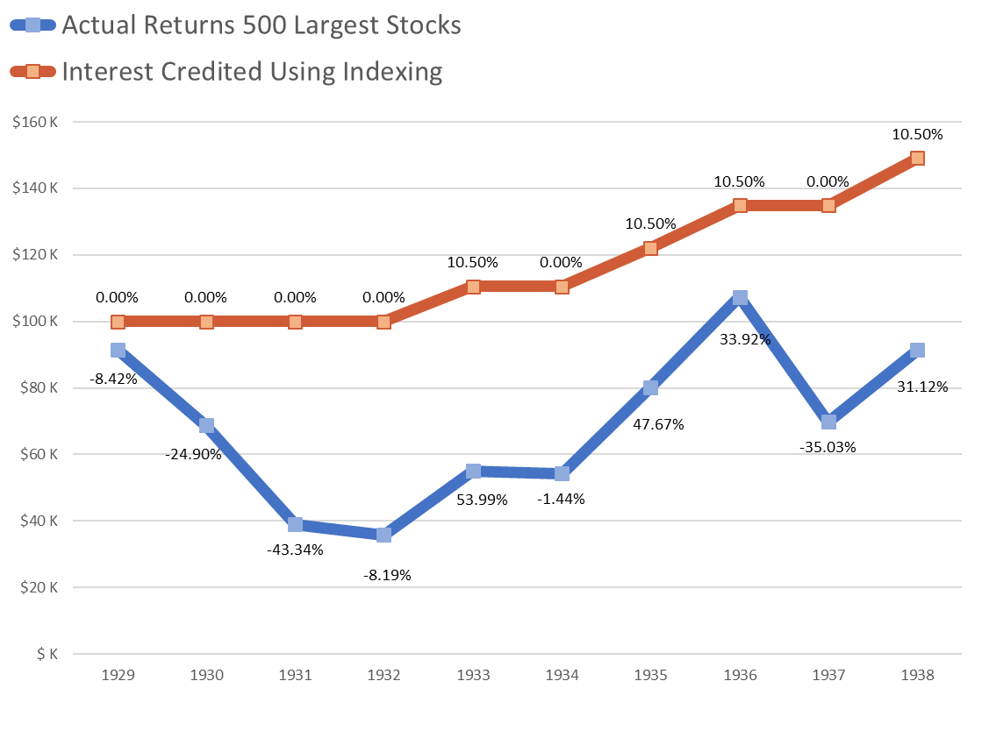
Example How An Index Would Have Performed During The Great Depression (1929-1938)
$149,090
4.07% Average Annual Return
$91,479
-0.89% Average Annual Return
This is a comparison of $100,000 invested between 1929 and 1938 in stocks reflected by the movement of the 500 largest stocks at the time including dividends (blue line) and the interest credited under an indexing method using the same 500 stocks with a hypothetical cap of 10.50% and a floor of 0.00% (orange line.)
The illustrated performance is not intended as an indication of future performance and is not guaranteed. This graph is only intended to demonstrate how the largest 500 stocks would be impacted by the hypothetical growth cap of 10.50% and hypothetical floor of 0.00%.

Slide 5
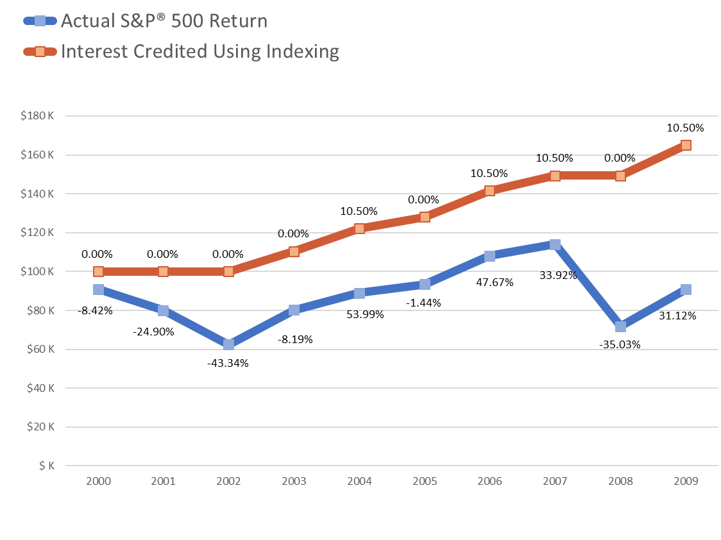
Example How An Index Performed During “The Lost Decade of Investing” (2000-2009)
$164,997
5.14% Average Annual Return
$90,883
-0.95% Average Annual Return
This is a comparison of $100,000 invested between 2000 and 2009 in stocks reflected by the movement of the S&P 500® including dividends (blue line) and the interest credited under an indexing method using the S&P 500® with a hypothetical cap of 10.50% and a floor of 0.00% (orange line.)
The illustrated performance is not intended as an indication of future performance and is not guaranteed. This graph is only intended to demonstrate how the largest 500 stocks would be impacted by the hypothetical growth cap of 10.50% and hypothetical floor of 0.00%.

Slide 6
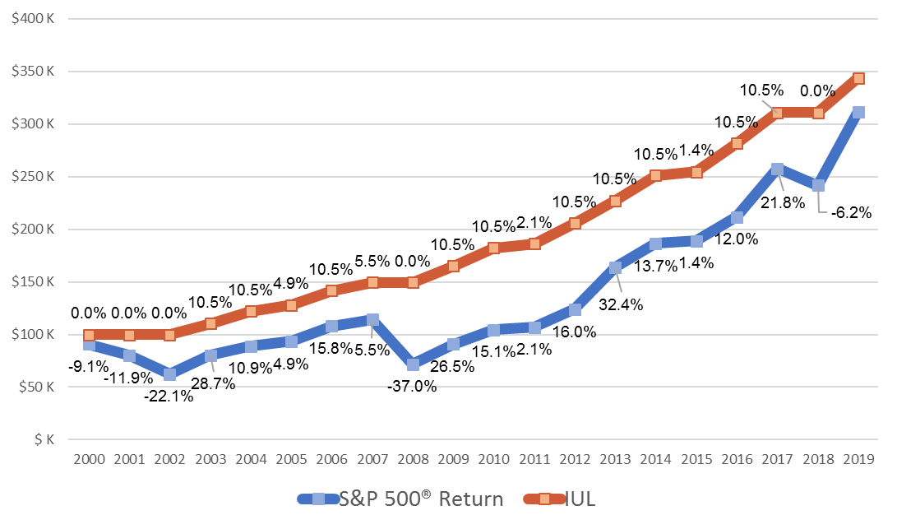
BENEFITS OF INDEXING The Downside Protection of Indexed Universal Life Can Lead To Higher Annual Returns Than The S&P500®
Compare $100k Invested Vs Credited Via Indexing Since 2000
$343,585
7.5% average annual return
$311,519
6.5% average annual return
This is a comparison of $100,000 invested between 2000 and 2009 in stocks reflected by the movement of the S&P 500® including dividends (blue line) and the interest credited under an indexing method using the S&P 500® with a hypothetical cap of 10.5% and a floor of 0% (orange line).

Slide 7
Edwin Mays
609-512-1655 (o)
609-964-1734 (f)
917-940-5835 (m)
Edwin@maysgroupadvisors.com

